Slide 1
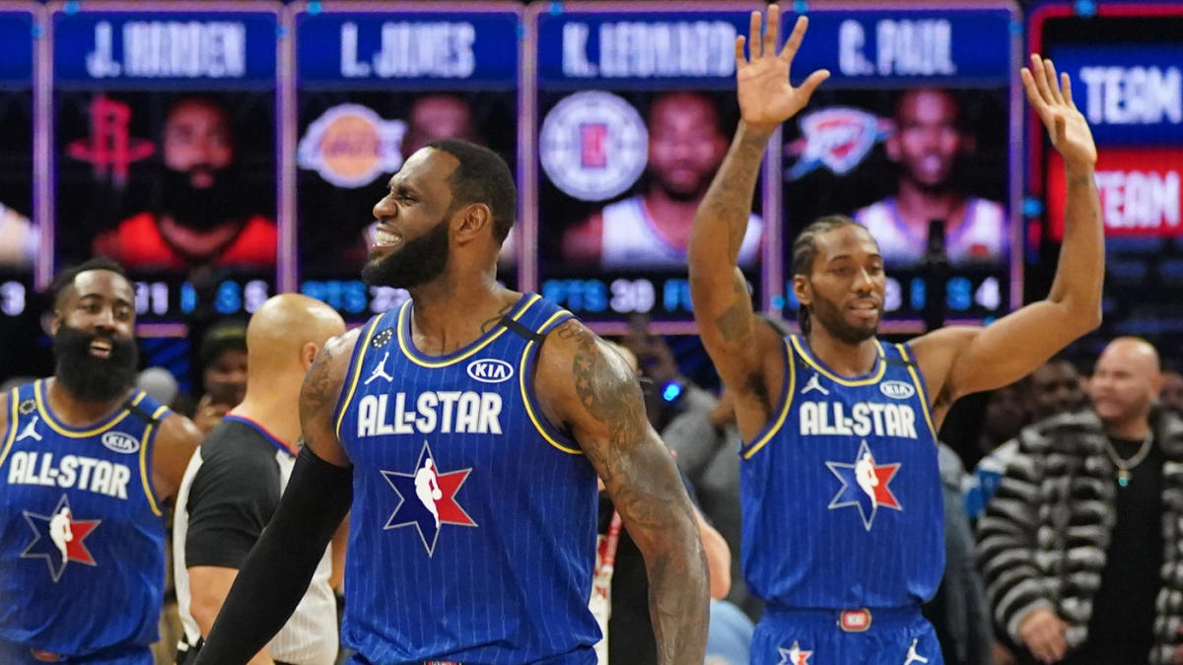
Predicting NBA Awards
William Reinhold
This Photo by Unknown Author is licensed under CC BY-NC-ND

Slide 2
Background
Wanted to be able to predict the All Star, All NBA, All Defense, and All Rookie Awards
Utilized Neural Networks to solve this
Would be useful for sports betting or building NBA rosters

Slide 3
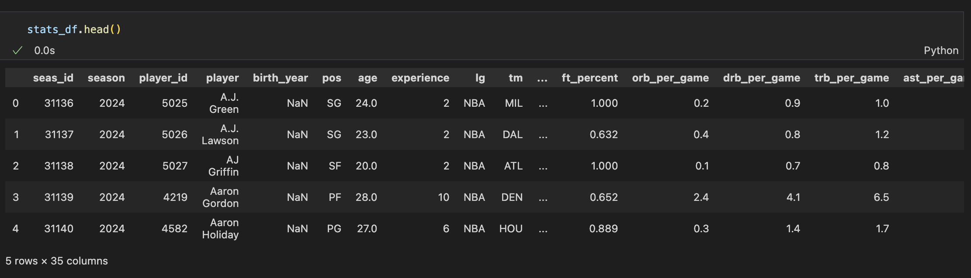
Data Cleaning & Storage
The data was stored in a PostgreSQL database.
The CSVs were imported into a Python file for cleaning.
I dropped unnecessary columns, filled null values, merged data sets, and created dummy variables to be used as the Y values.

Slide 4
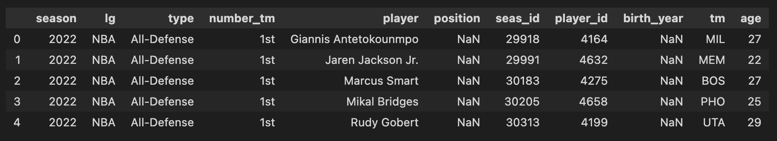
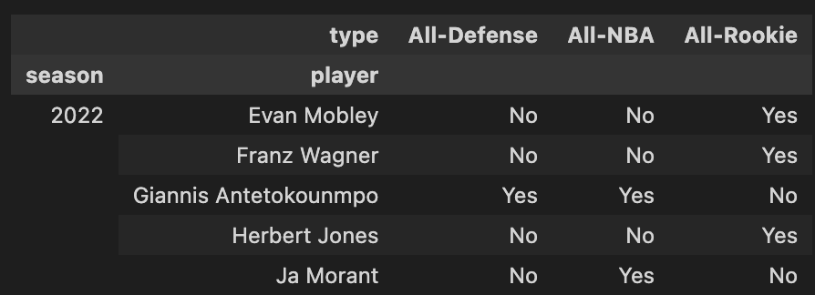
Before & After

Slide 5
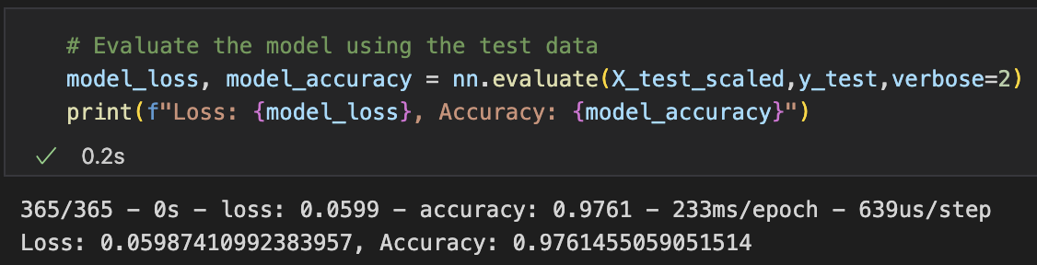
Building the models
I decided to build four different models using neural networks.
The models needed different data, so there was some additional cleaning for each.
Each model was saved to an h5 file and was over 96% accurate.

Slide 6
Final Thoughts
These models were effective in determining the outcomes of the 4 awards I chose.
To improve it, I would try to look at a player’s progression over multiple seasons to forecast the future performance.
It could also be useful to add in data on team success, as that would have some effects on the model.

Slide 7
References
Project can be found at https://github.com/wreinhold/nba-awards-predictor.
Data is sourced from https://www.kaggle.com/datasets/sumitrodatta/nba-aba-baa-stats?resource=download.
The following websites were used as guides
Stackoverflow.com
Pandas.pydata.org
Tensorflow.org

